Slide 1
US superstore Data Analysis using Tableau
Tableau Capstone Project
By Akhilesh Mishra
DS20DEC03

Slide 2
Link of video in drive (open)
https://drive.google.com/file/d/1YJ9Jm3VvzQmZUCQpQB3zCe26MSvqeFhA/view?usp=sharing
Complete file in drive link
https://drive.google.com/drive/folders/1CwvWXmmkL1bs0EPxSast0gQpqaiIFQDE?usp=sharing

Slide 3
US superstore dataset
Us superstore dataset consist of
Row id postal code
Order id region
Order date product Id
Ship date category
Ship mode sub-category
Customer id product name
Customer name sale
Segment Quantity
Country discount
City profit
State

Slide 4
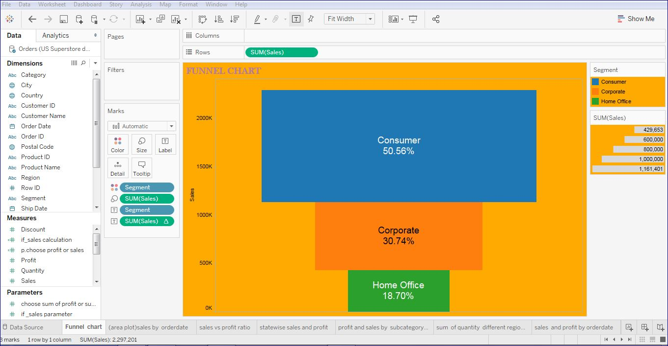

Slide 5
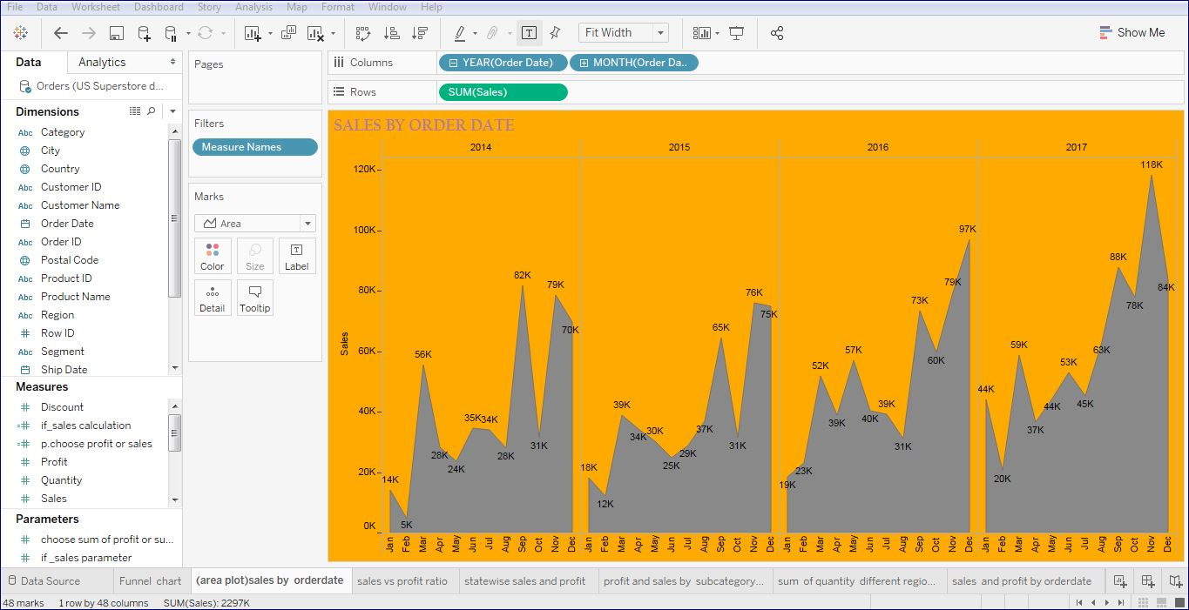

Slide 6
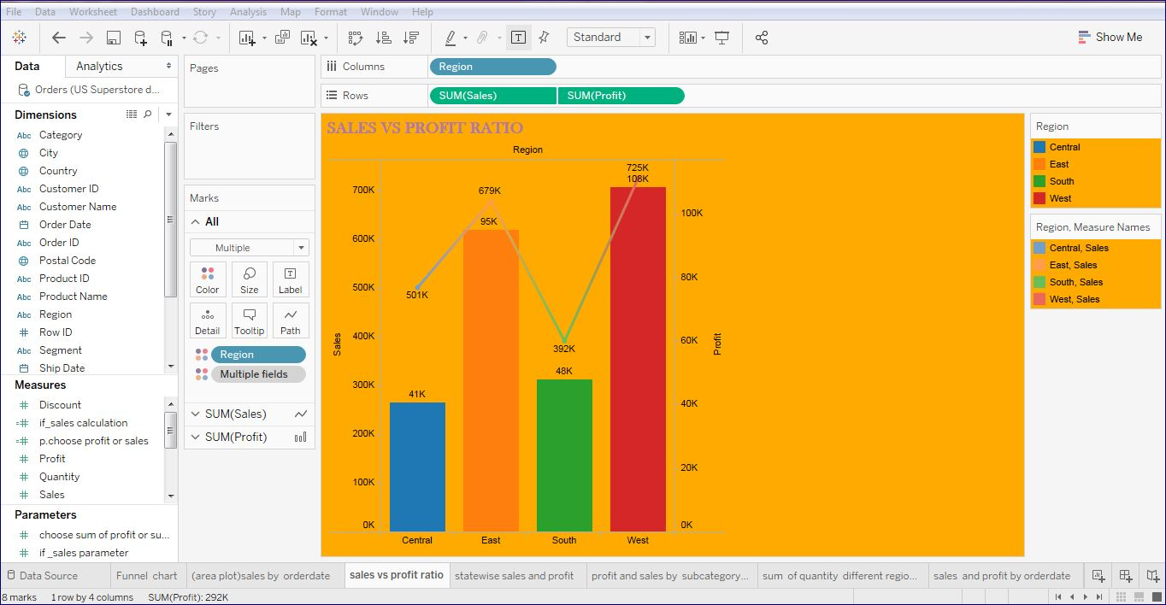

Slide 7
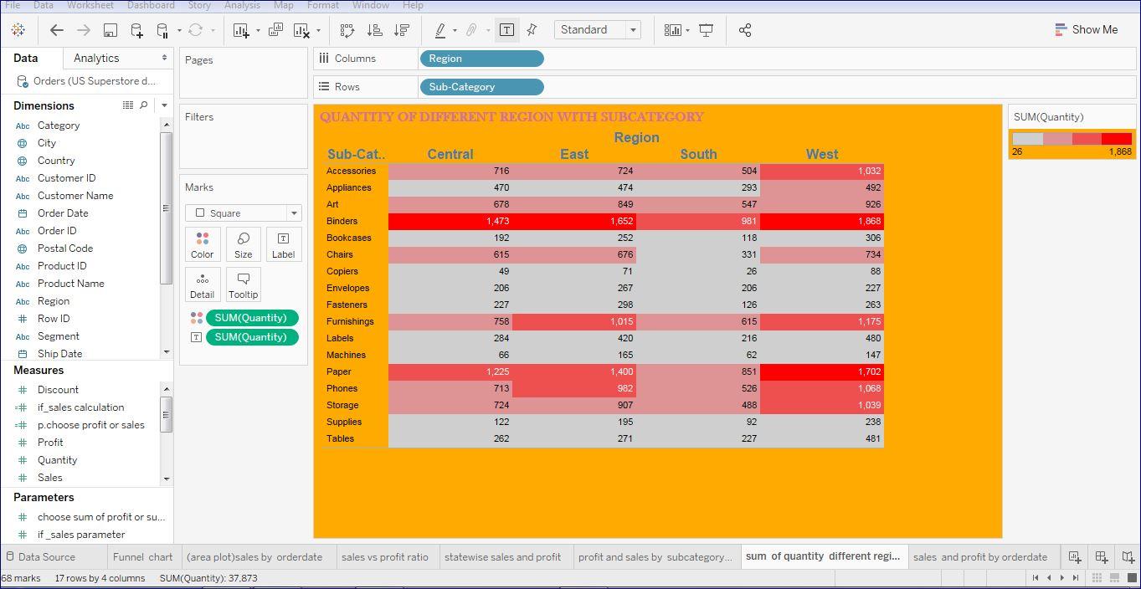

Slide 8
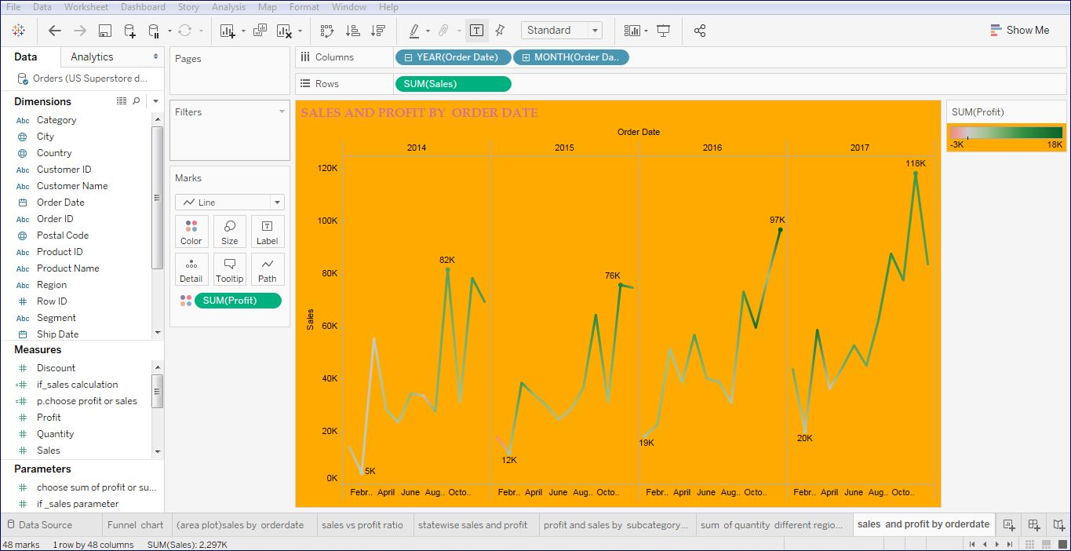

Slide 9
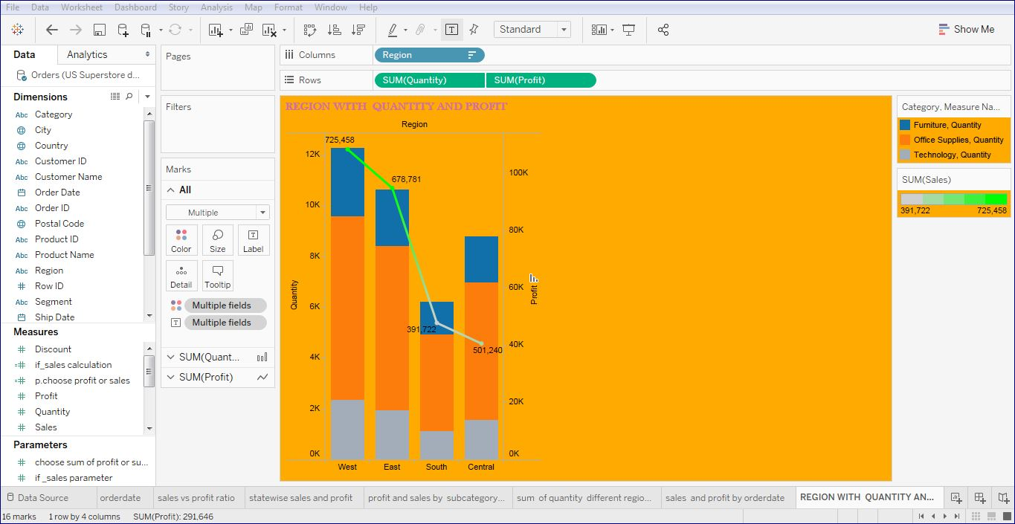

Slide 10
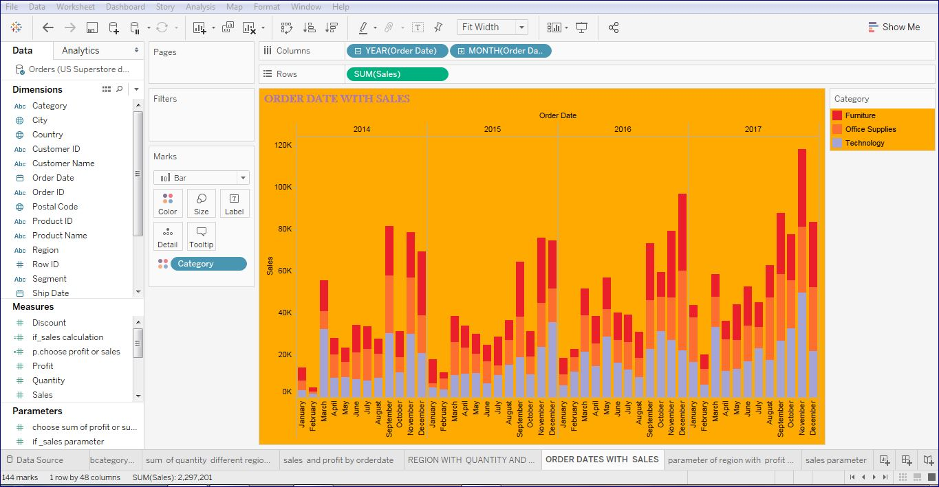

Slide 11
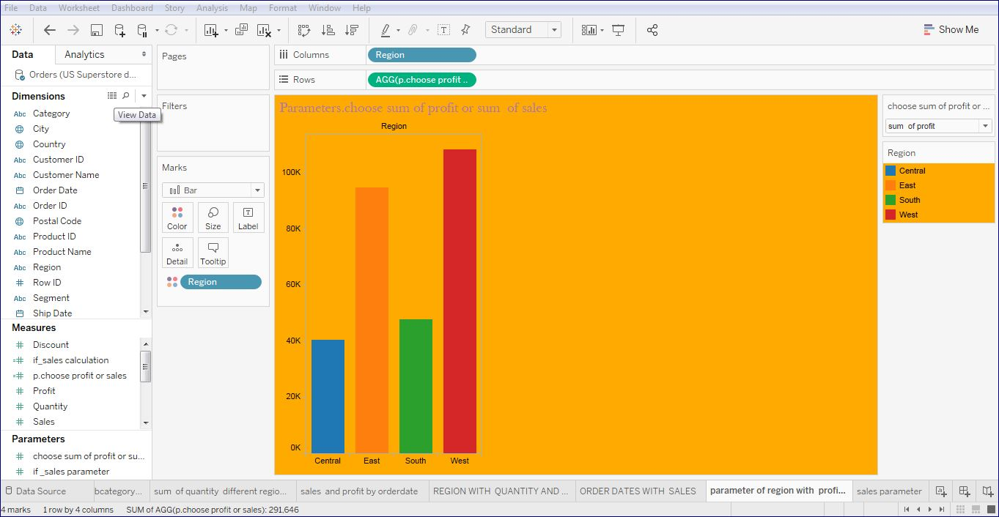

Slide 12
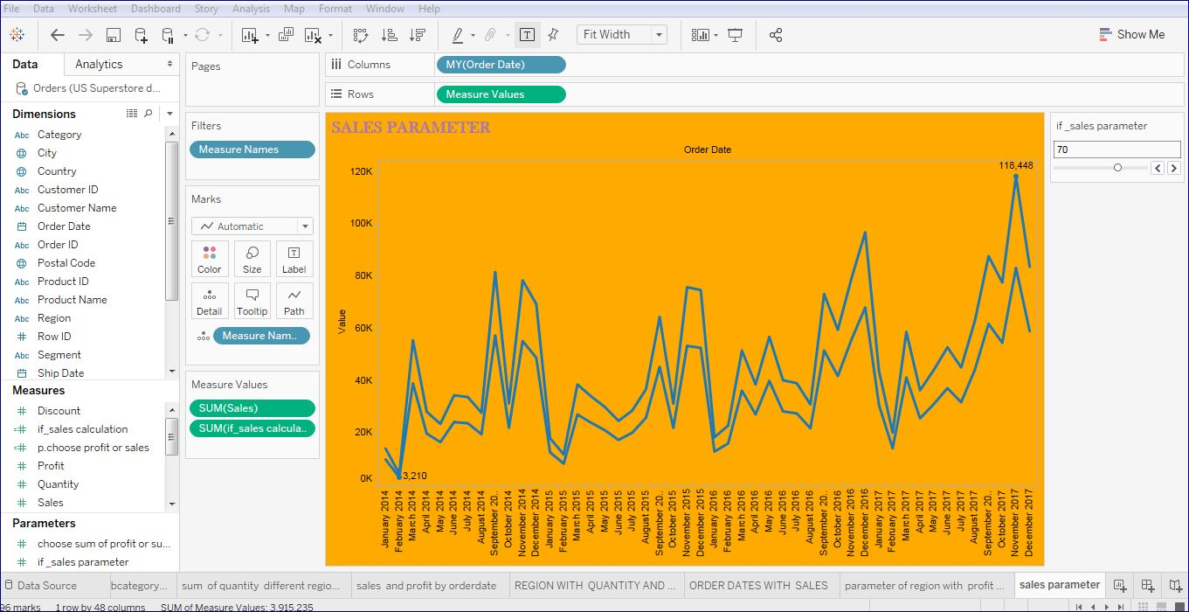

Slide 13
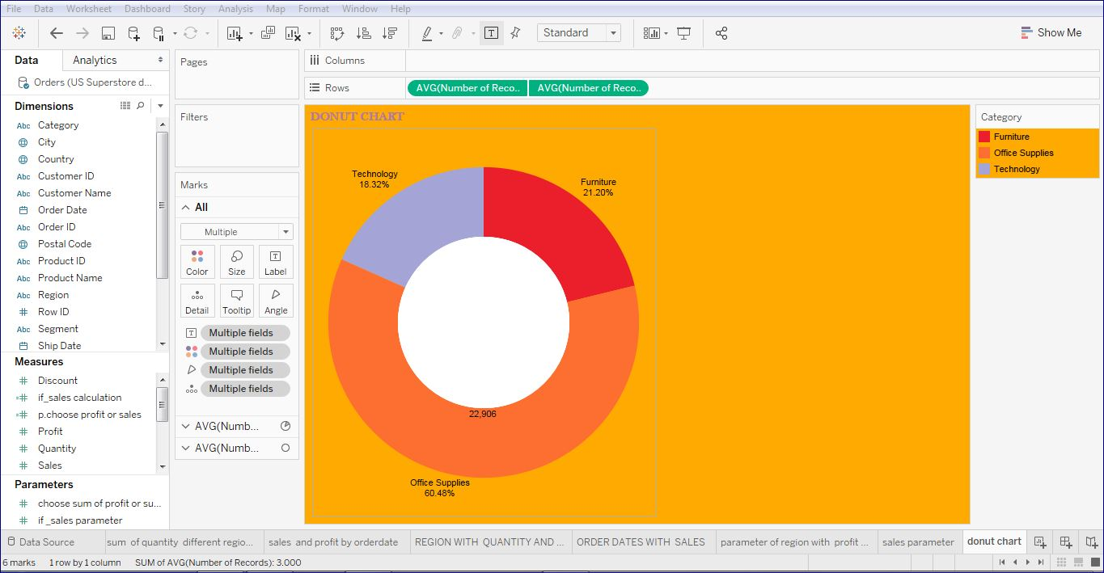

Slide 14
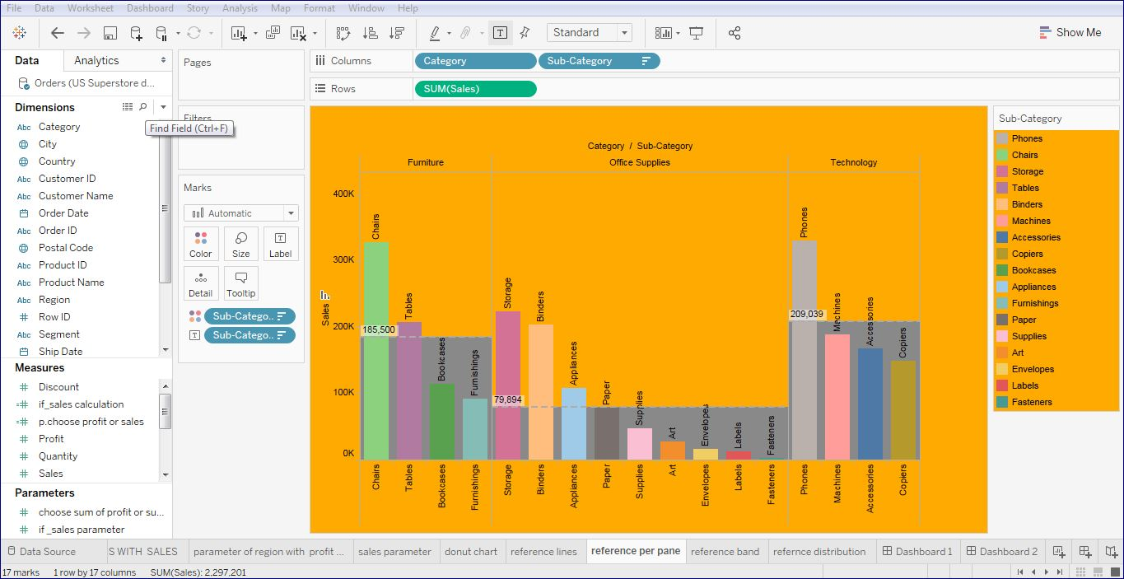

Slide 15
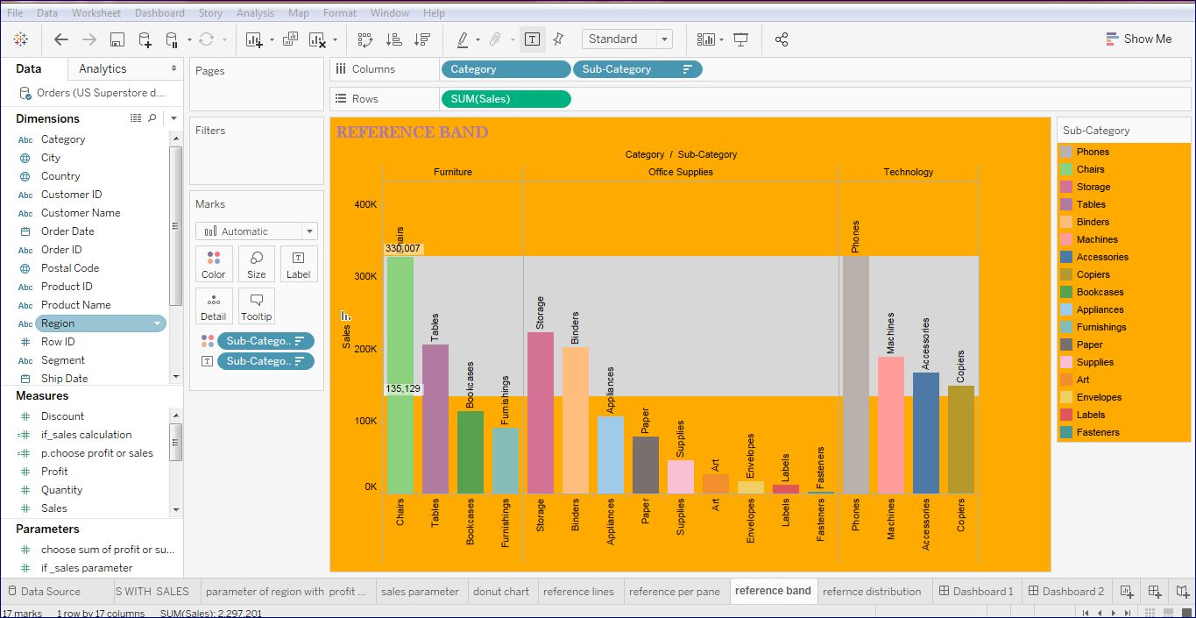

Slide 16
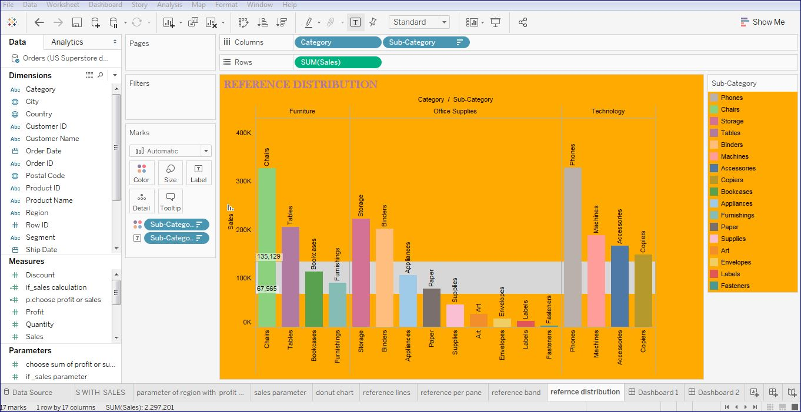

Slide 17
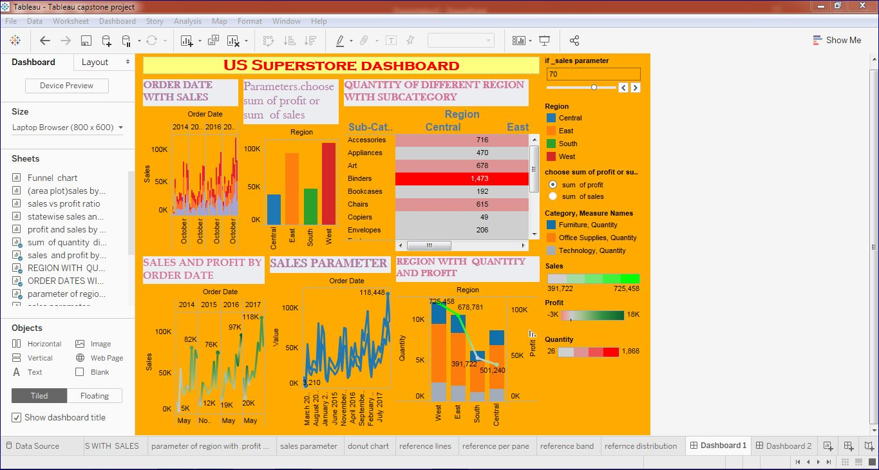

Slide 18
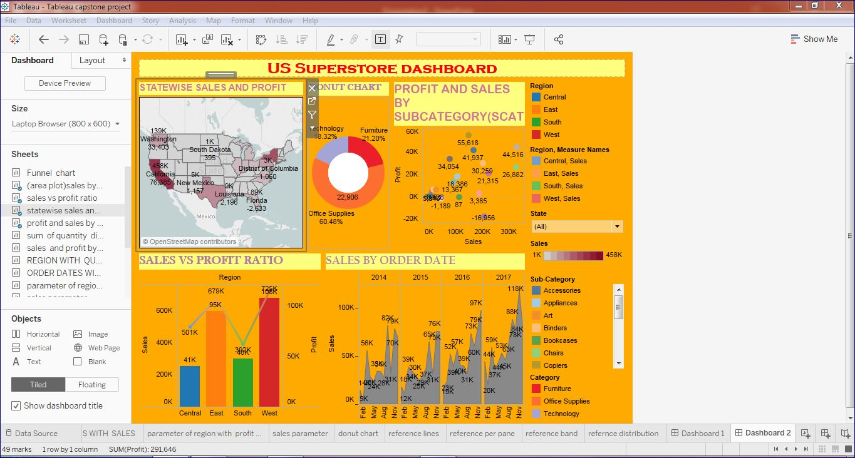

Slide 19
Thank you

